Slide 1


NEWSLETTER
101
Office of Marketing & Communications

Slide 2

WHO IS CURRENTLY DOING NEWSLETTERS?
How often?
Department?
What Audience(s)?
Notes:
Once a year? Twice a year, once a quarter? Monthly? Weekly?
Who are you sending them to – faculty? Students? Alumni? Other?

Slide 3
BASIC NEWSLETTER FORMAT
Letter from department head with links to development funds
Digital signature file in black ink
1-2 research or faculty highlights
1-2 student highlights
1-2 alumni highlights
Upcoming events
Standard closing message: mentor, give, stay connected, merch

Slide 4
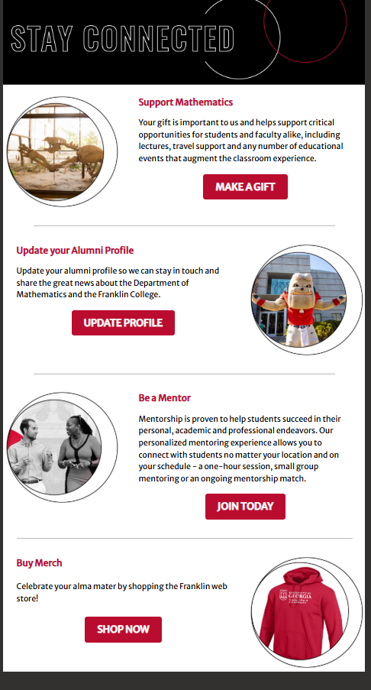
CLOSING ITEMS
Four Item to Close:
Support the Department
Update your Alumni Profile
Be a Mentor
Buy Merch

Slide 5
CONTENT IS KEY!
Goal - actively gathering content along the way
More difficult to write the entire newsletter in a week
Key is to gather content and then post to your website
Newsletter gives a paragraph or two summary and links to the web page

Slide 6
POST YOUR EVENTS
Post your events to the UGA Calendar: calendar.uga.edu
Post your events to your department website
Post your events to main Franklin website

Slide 7
THINK LIKE YOUR AUDIENCE
What do you think they want to hear?
How do you want them to act?
How do you want them to feel?
What do you want them to do?

Slide 8
HOW TO GATHER CONTENT
Make a template with a series of questions that students can use to interact with guest speakers and alumni
Make a template with questions for student profiles/clubs
These forms help create a series with cadence and consistency
Ask interviewee to submit photo or have student take photo at event/lecture
Ask tour ambassadors/clubs to submit content – words/photos
Great research and “&” stories
Post events consistently
Create content once – use it as many places as possible

Slide 9
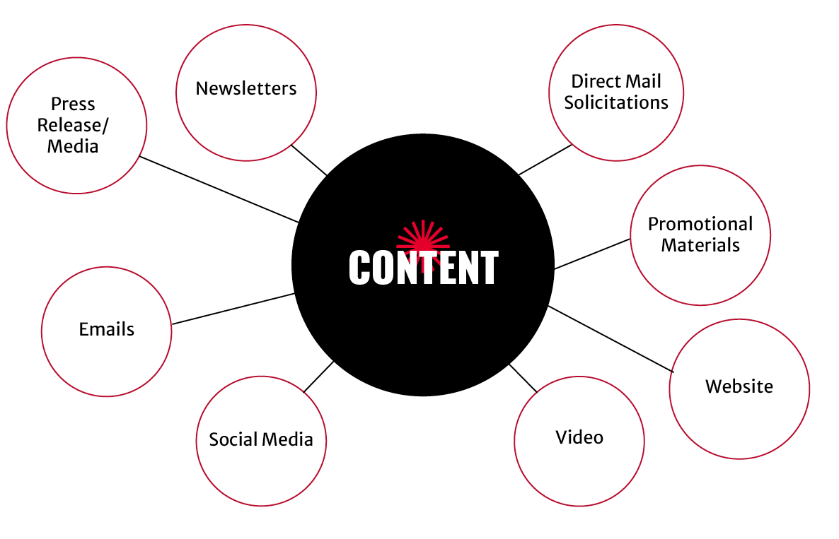
CONTENT
Newsletter
Website
Events
Social
Digital boards
Emails
Brochures
Can pitch to MARCOM and/or DARCOM
SUBMIT STORY IDEAS TO
FRANKLINSTORIES@UGA.EDU

Slide 10
LEANING INTO THE
&
Notes:
Our sub of brand provides the foundation for us to share all of the great things at Franklin….we will be leaning into the “and”…and have some highlights to share today of what’s already happening here

Slide 11
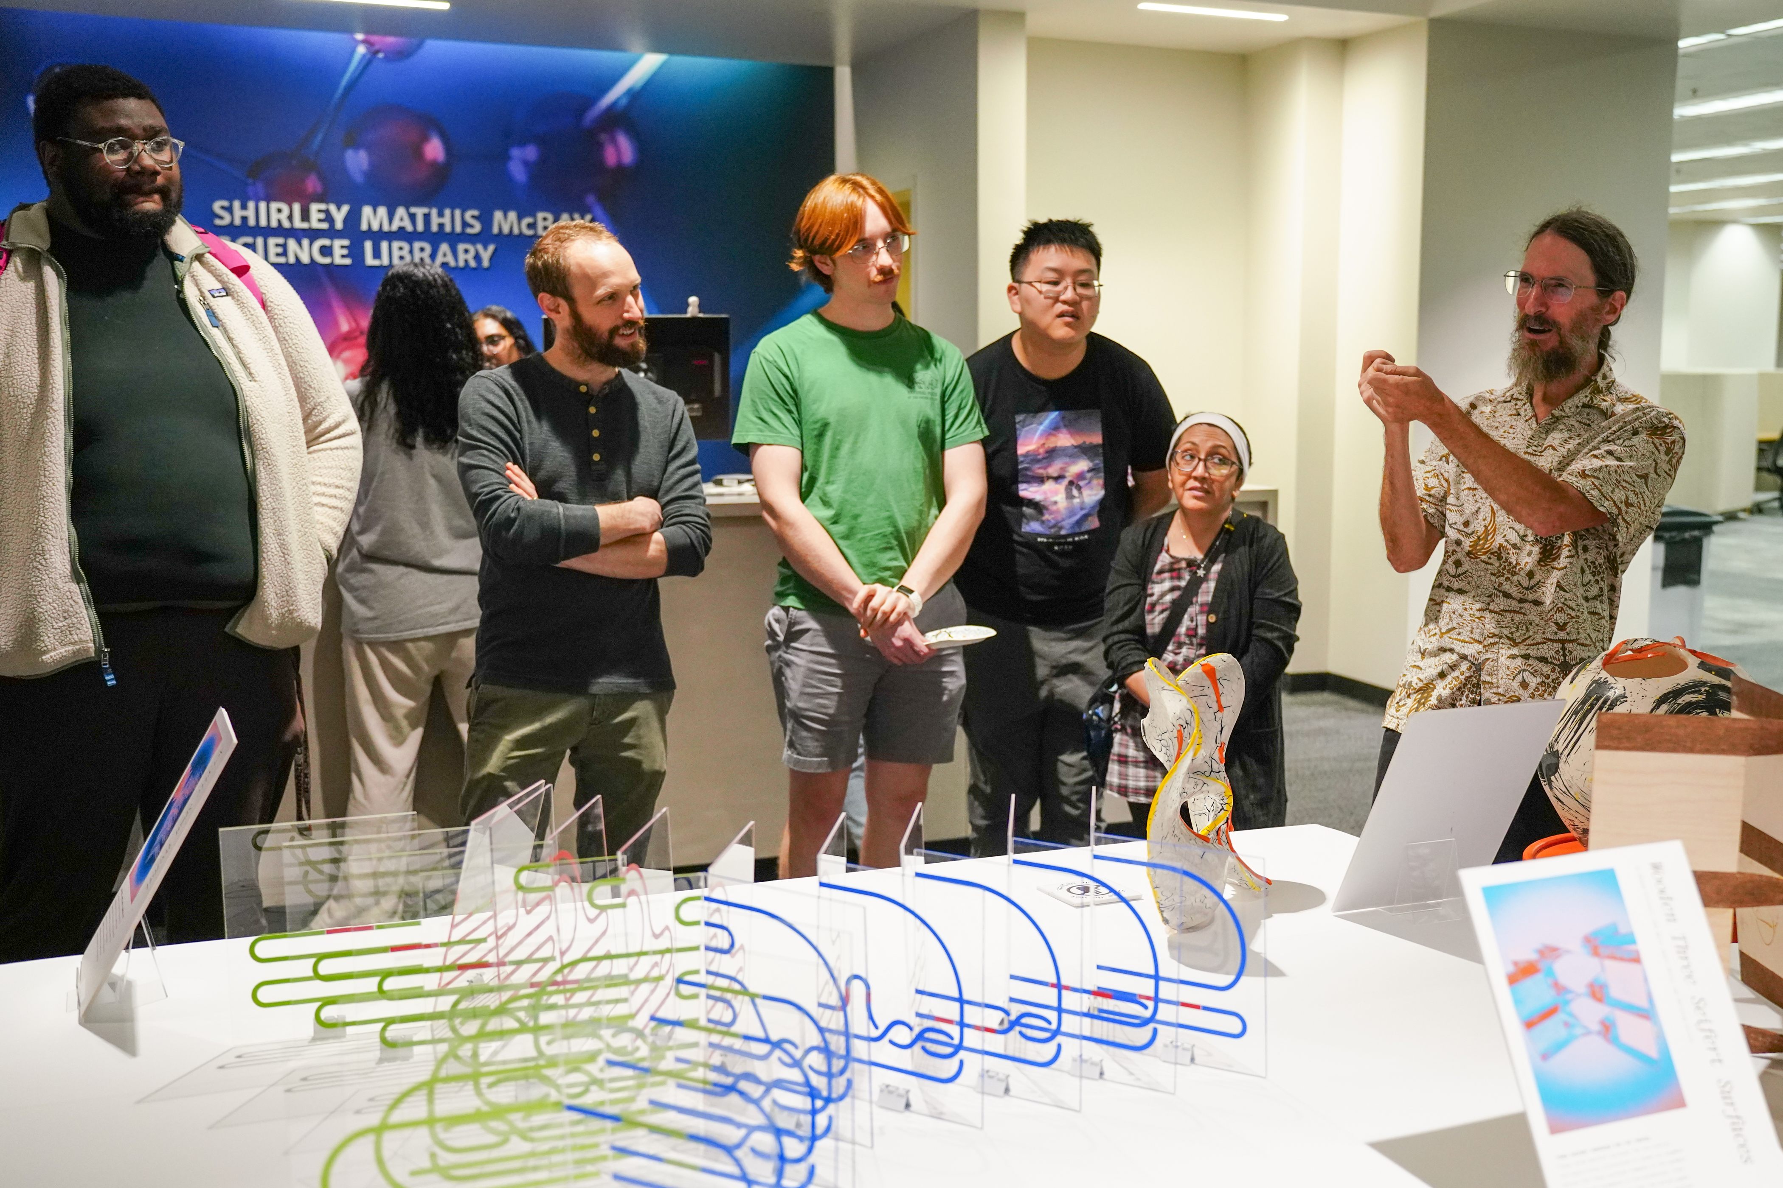
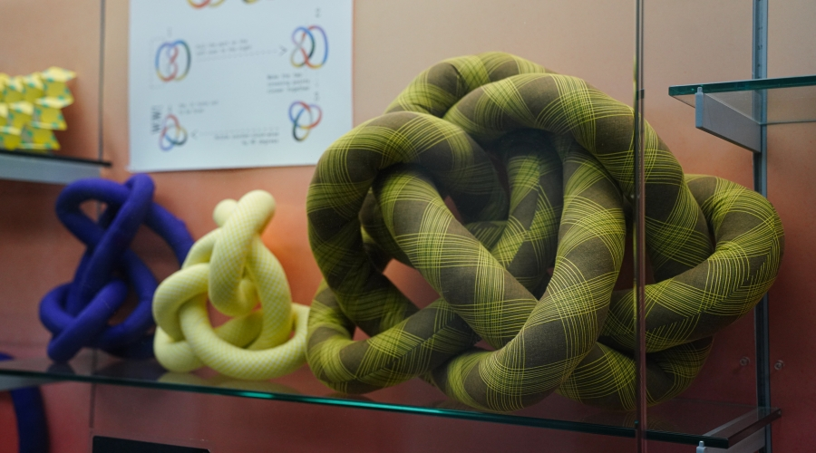
Art + Math make a GROVI connection
Designer and artist Moon Jung Jang met mathematician David Gay through the UGA Arts Collaborative, a research incubator that encourages collaboration across the arts and sciences, and between the university and the Athens community. Since 2017, the two professors have engaged in design workshops, co-taught an interdisciplinary course, and curated a student exhibition weaving mathematics and design.
Notes:
Groovy combines
Geometry Research Outreach and Visualization Initiative

Slide 12
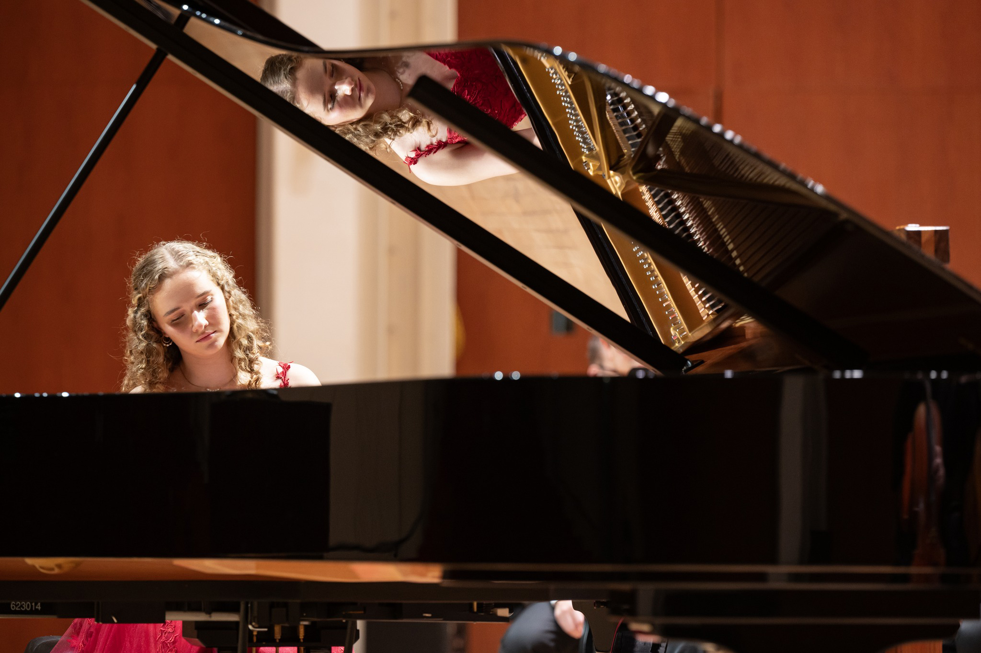
Following dual tracks: Student pursues music and medicine
What’s an artist to do when she wants to pursue medicine alongside piano? Choose the University of Georgia and continue with both. Caroline Malcom, a second-year Honors student and Cora Nunnally Miller Scholar in the Fine Arts, is majoring in piano performance in the Hugh Hodgson School of Music while also on a pre-medical track in the Franklin College of Arts and Sciences. She chose to major in piano performance to grow as an artist, by “studying music in its entirety and learning the discipline necessary to perform a challenging repertoire,” she said.
Notes:
Caroline Malcom combines music and medicine

Slide 13
SAMPLE STORY LAYOUT
Questions provided by Franklin Marketing and Communications
Student conducted interview and attended event
Franklin Marketing and Communications reviewed/edited

Slide 14
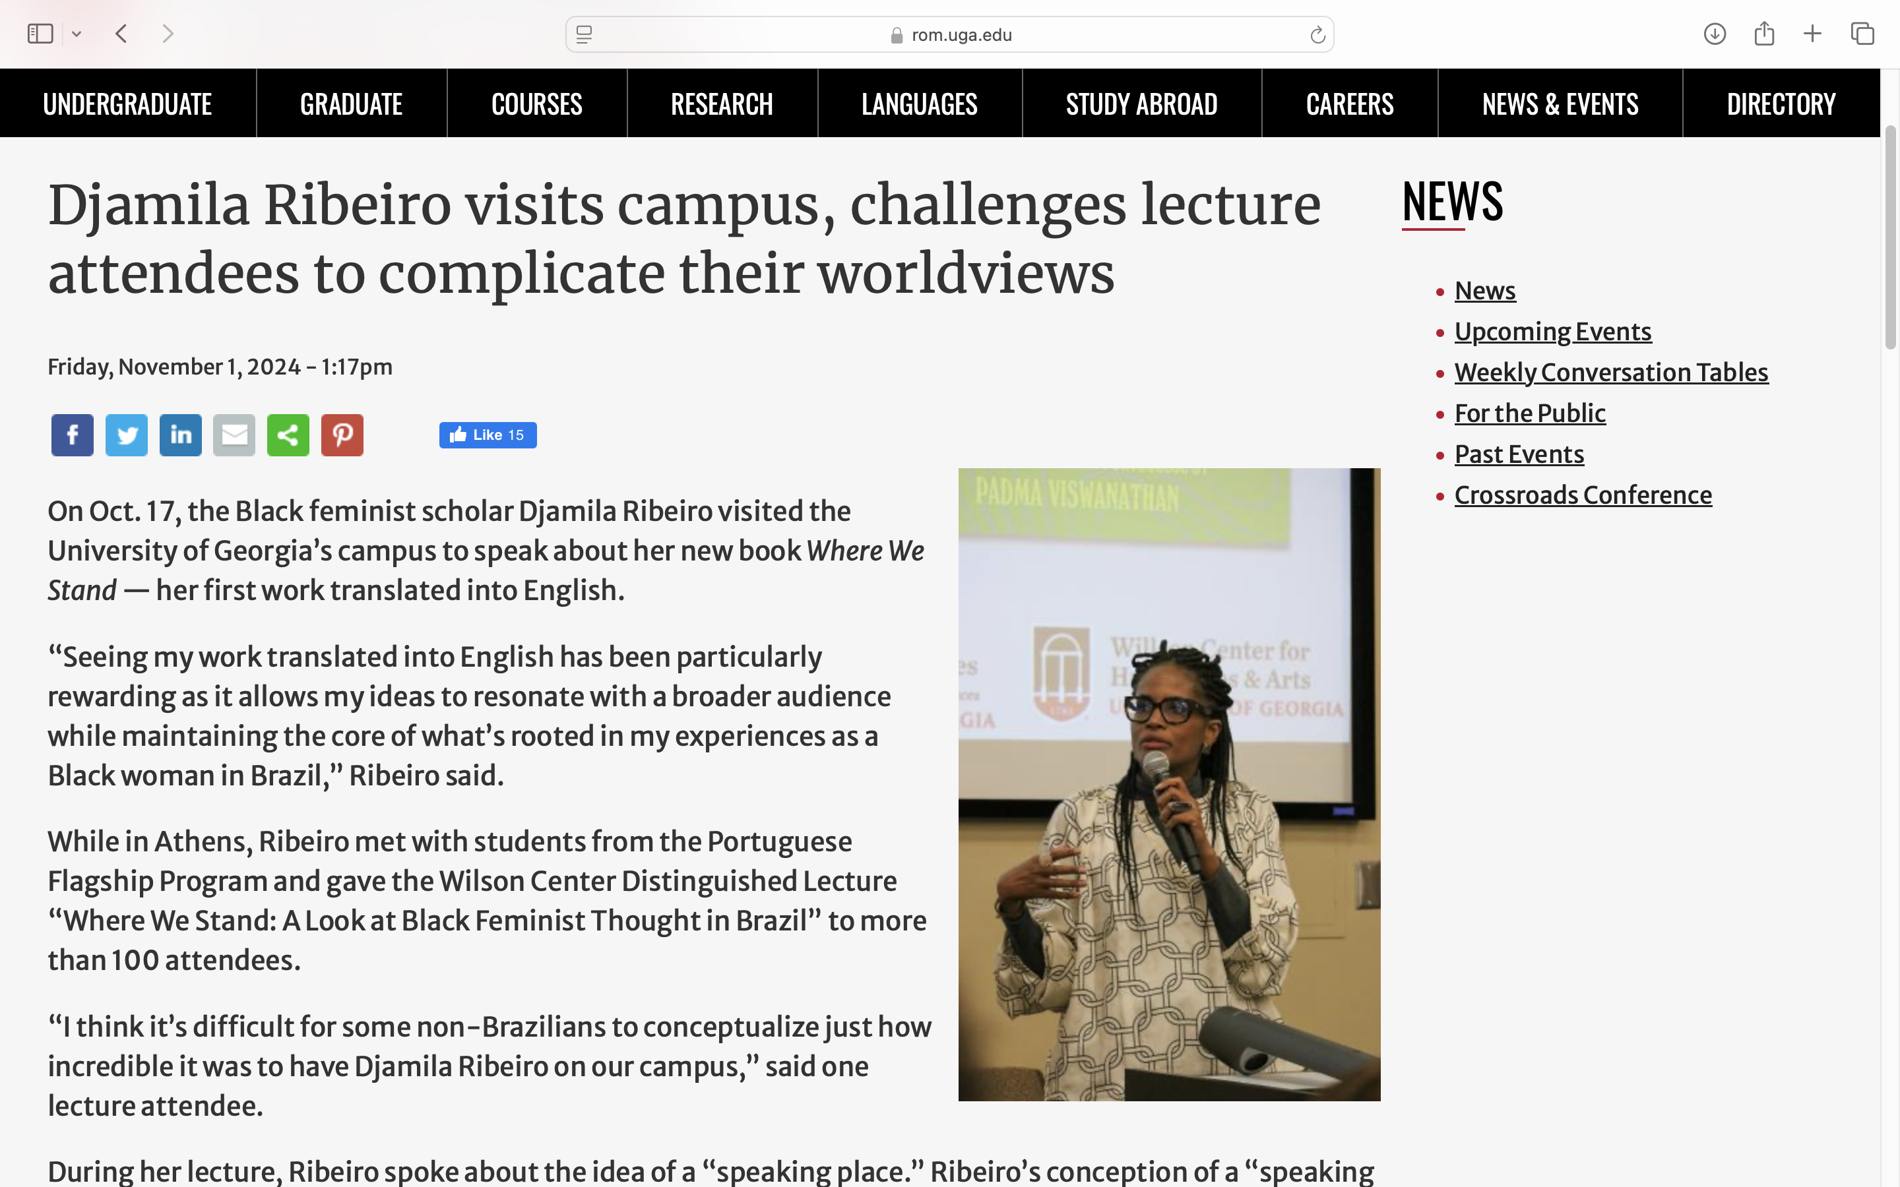
STUDENT INTERVIEWS GUEST LECTURER

Slide 15
EXAMPLES OF A SERIES OF QUESTIONS
We used these questions to generate multiple stories/posts for Department of Dance
What first attracted you to the UGA Department of Dance?
2. Please describe, in one sentence, your program of study at UGA:
3. Did you know when you accepted your admission to UGA that you would have the opportunity to choose a double major, or an additional field of study with Dance as a Minor or Major, or to study abroad?
4. Please describe the process of working with your advisors:
5. On a scale of 1-10, with 10 being “Most Important,” was the opportunity to study in the UGA Department of Dance, and your ability to expand your studies beyond Dance, important to your decision to study at UGA?
6. Describe how your study of Dance is important to, or complements, your full program of study at UGA?
7. Have you, or will you, take advantage of any of UGA’s Study Away programs while you are a student in the UGA Department of Dance?
8. In your own words, please complete the phrase “Dance and (your additional Major or Minor, plus any certificates) will prepare me for a future in (your chosen field):
9. If you were speaking with a prospective student, how would you describe your experience in the UGA Department of Dance, and your ability to expand your studies at UGA?

Slide 16
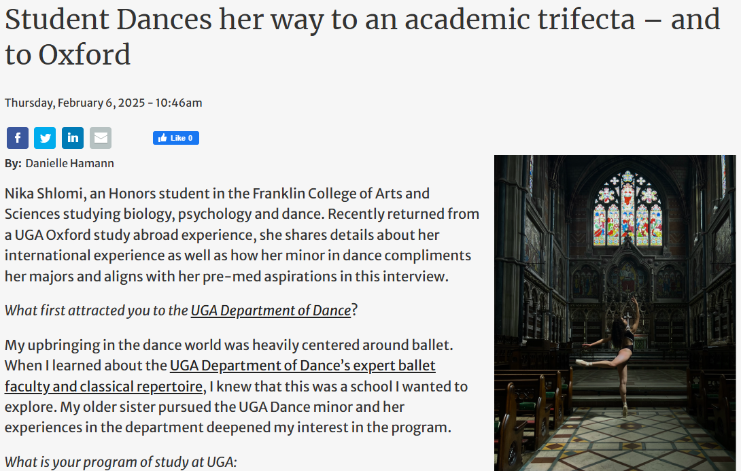
STUDENT’S QA STORY

Slide 17
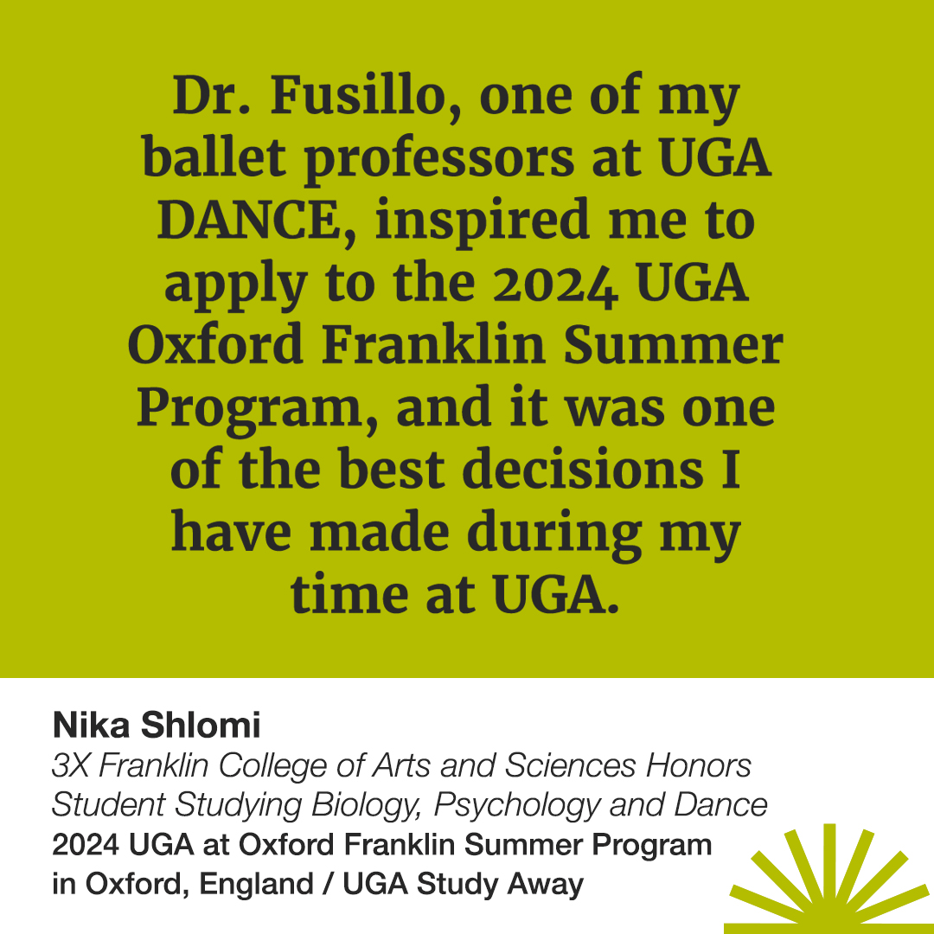
STUDENT SOCIAL

Slide 18
ALUMNI QUESTIONS
What piece of advice would you give to students?
Why did you select the University of Georgia? Why did you select your degree?
What experience during your time at Franklin College had the biggest influence on where you are today?
How does your degree fit into your current role?
Did you participate in any study abroad, experiential or interdisciplinary studies? If yes, please share details.
What would you tell your 20-year old self – lessons learned
What skills should graduates have for success early in their careers?
What accomplishment are you most proud of?
What is your biggest strength and how has that helped you be successful?
How do you get inspired?
What is your favorite UGA memory?
Favorite place you’ve traveled or item on your bucket list?

Slide 19
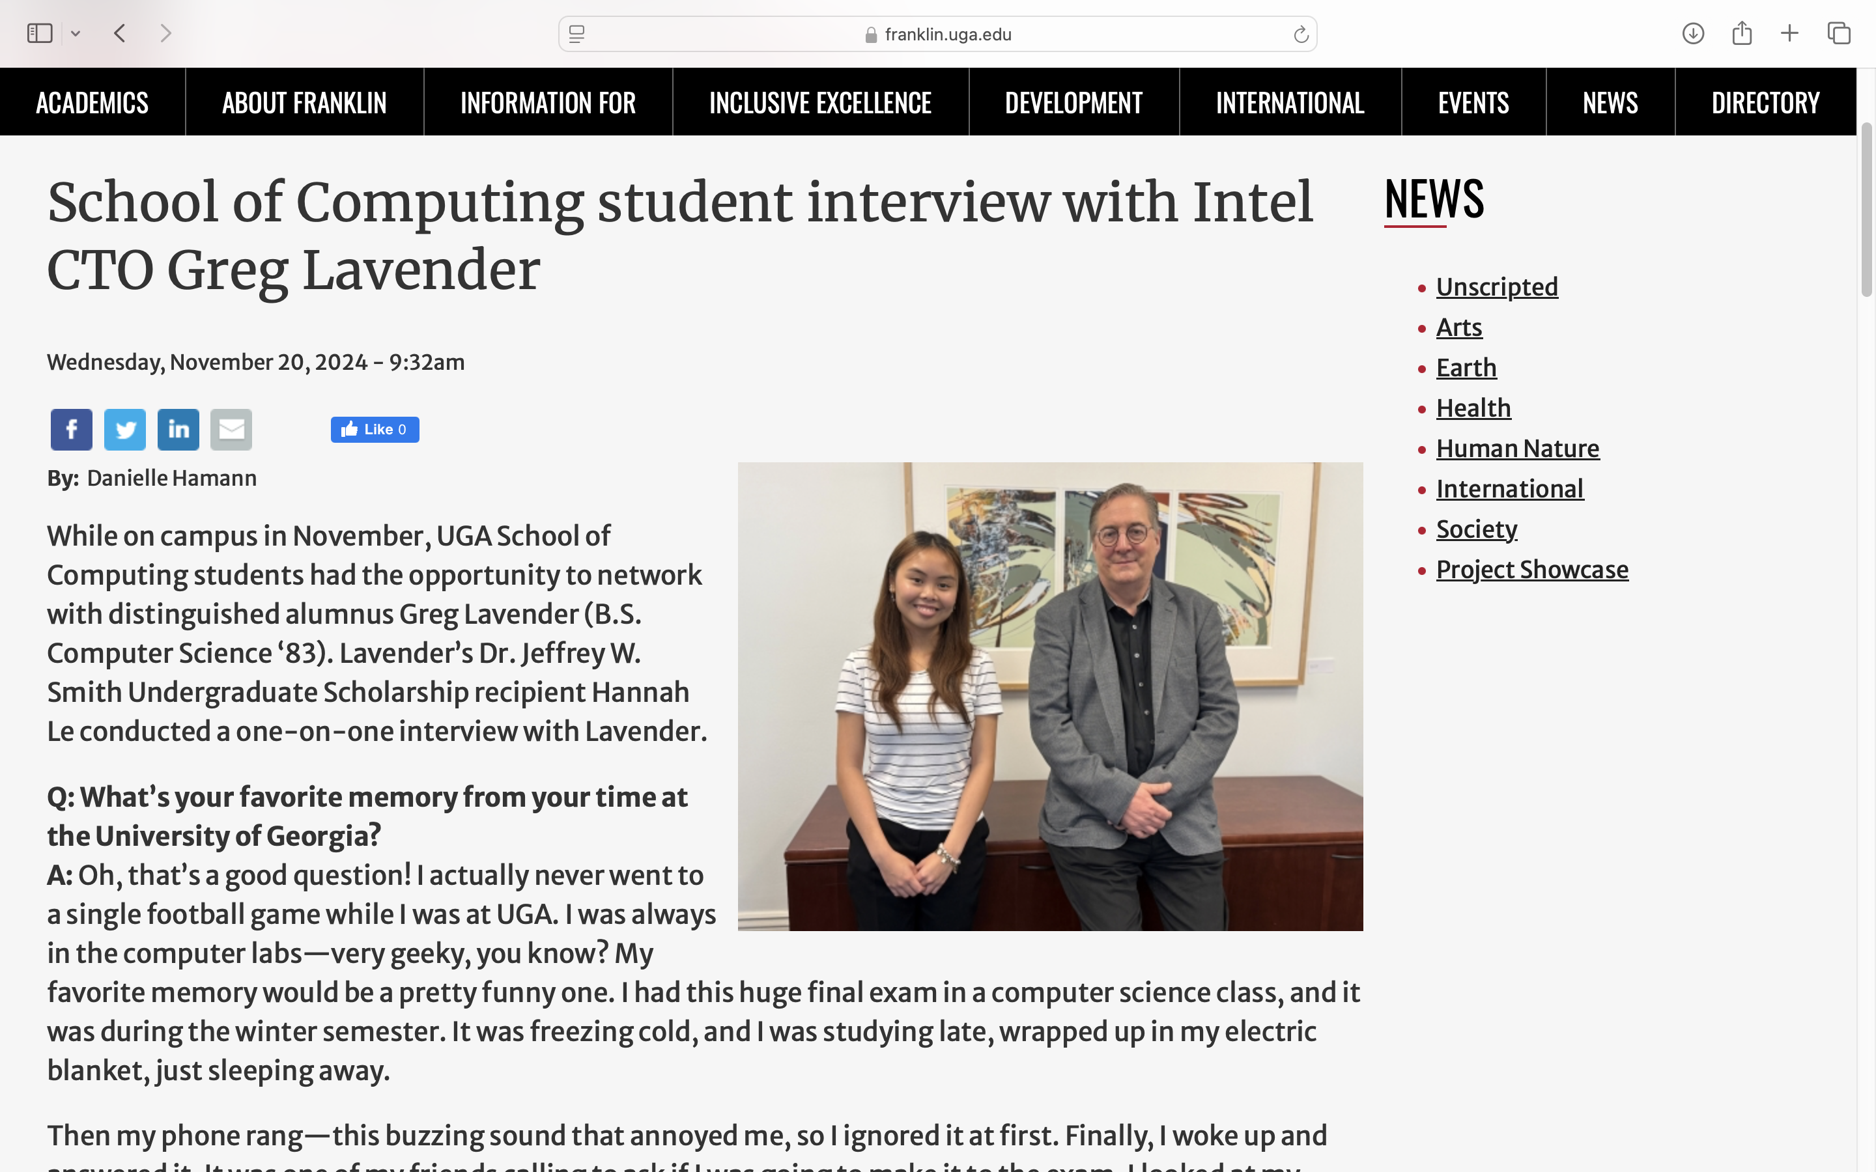
ALUMNI INTERVIEWED BY SCHOLARSHIP RECIPIENT

Slide 20
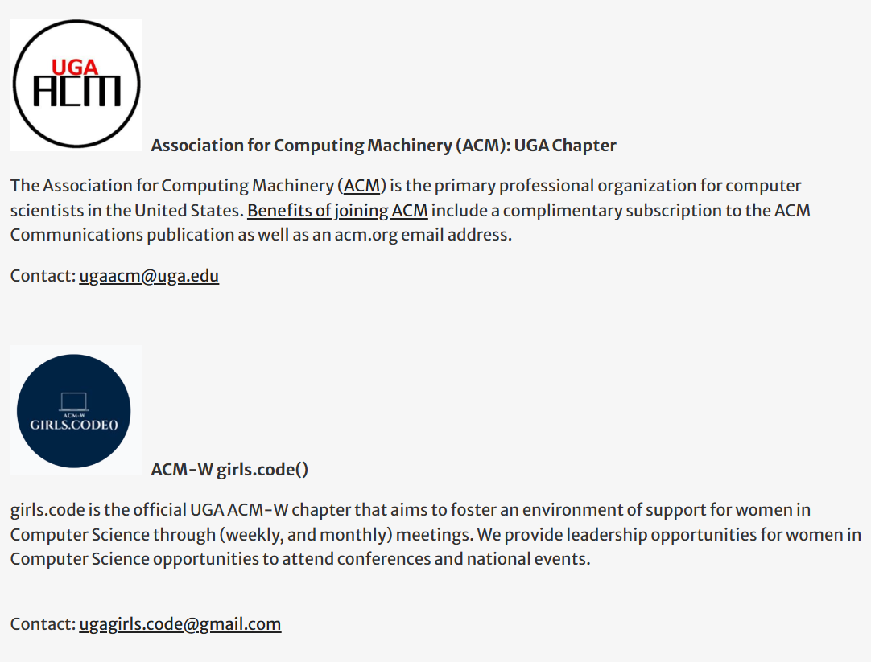
CLUB EVENTS AND ACTIVITIES
Ask club leaders to submit content, including images

Slide 21
PHOTOGRAPHY TIPS
Students with the guest speaker
Alumni visit to UGA
Ensure photo is properly cropped and clear
Generic UGA photography is available at mc.uga.edu/photo

Slide 22
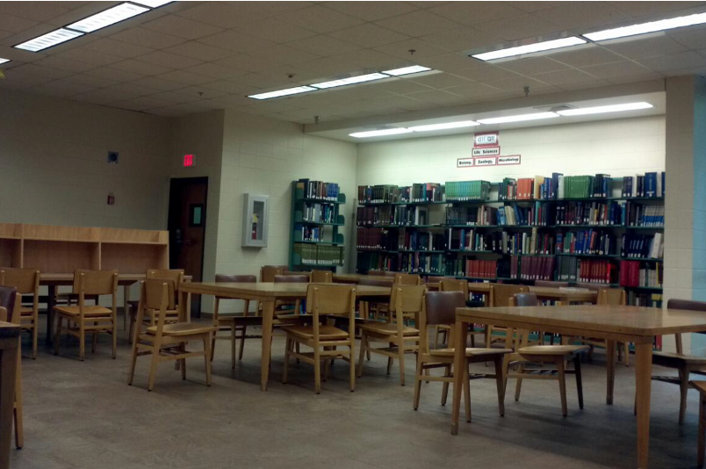
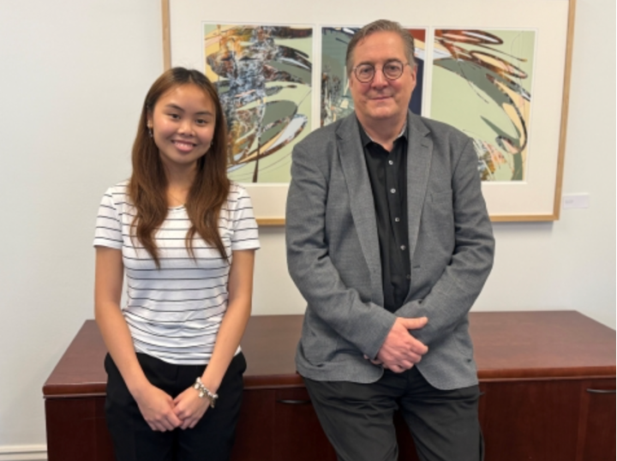
EXAMPLES OF GOOD AND BAD PHOTOGRAPHY
Good!
Highlights individuals
Up-close
Clear image
Up-to-date
Bad
Far away
Blurry
Outdated

Slide 23
CONSIDER WHAT IS THE RIGHT CADENCE
Do you have a big annual event you want to promote?
Start small, one a newsletter a year – we recommend 1x/yr
Consistency builds credibility
Monthly and quarterly are hard to sustain, there are a lot of end-of-the-year pushes
Think through best timing for your department and audience – align with your goals

Slide 24
FRANKLIN MARKETING & COMMUNICATIONS HAS A QUARTERLY ALUMNI NEWSLETTER
Share your ideas with us for consideration
We started a parent newsletter – also quarterly – share your ideas with us!
We’d love to tap into your student newsletters – share info – ala Franklin Fest, etc.

Slide 25
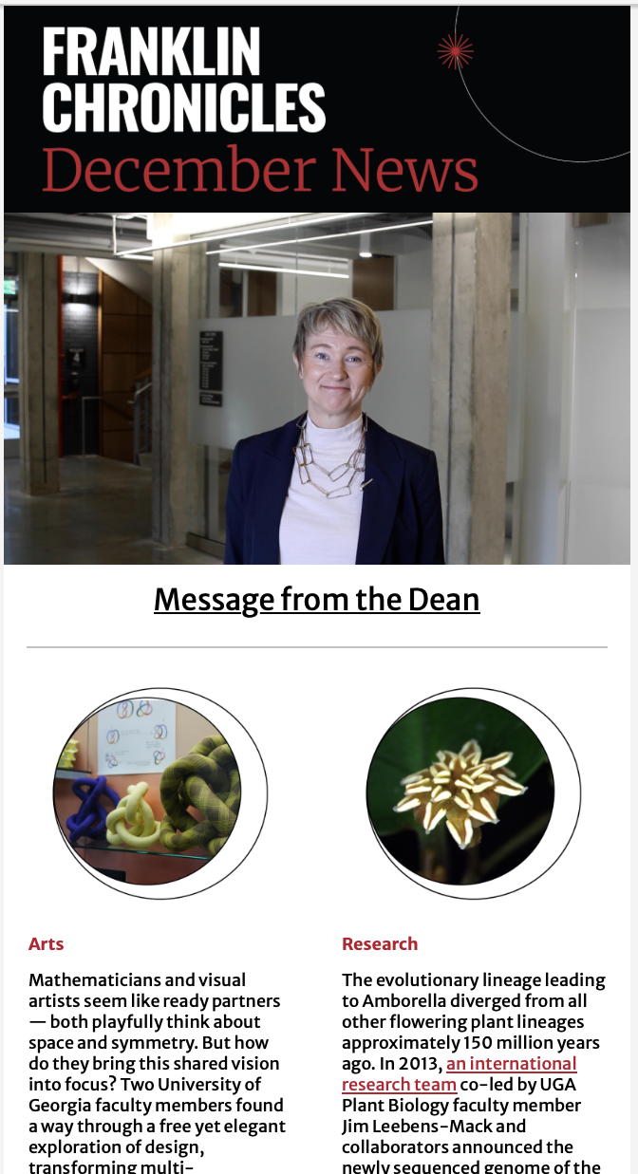
OTHER QUICK TIPS!
PDF formats are not permitted to send via email – they create opt-outs for the entire system and are not the best
Franklin MarCom has templates and can format and send
Track engagement – can see what stories are most liked and tailor items moving forward

Slide 26
WORKING WITH FRANKLIN MARCOM
Submit request at least 2 months in advance via franklinmarketing@uga.edu
For those of you we know/work with – Kendra reaches out prior month with email including content deadline
Content (with links) due the 20th the month prior
Review process (1-2 rounds)

Slide 27
ANY QUESTIONS?
Thank you for listening!

